Slide 1
Chapter 14
Big Data and NoSQL

Slide 2
Learning Objectives
After completing this chapter, you will be able to:
Explain the role of Big Data in modern business
Describe the primary characteristics of Big Data and how these go beyond the traditional “3 Vs”
Explain how the core components of the Hadoop framework operate
Identify the major components of the Hadoop ecosystem
Summarize the four major approaches of the NoSQL data model and how they differ from the relational model
Describe the characteristics of NewSQL databases
Understand how to work with document databases using MongoDB
Understand how to work with graph databases using Neo4j

Slide 3
Big Data (1 of 4)
Volume: quantity of data to be stored
Scaling up: keeping the same number of systems but migrating each one to a larger system
Scaling out: when the workload exceeds server capacity, it is spread out across a number of servers
Velocity: speed at which data is entered into system and must be processed
Stream processing: focuses on input processing and requires analysis of data stream as it enters the system
Feedback loop processing: analysis of data to produce actionable results
Variety: variations in the structure of data to be stored
Structured data: fits into a predefined data model
Unstructured data: does not fit into a predefined model

Slide 4
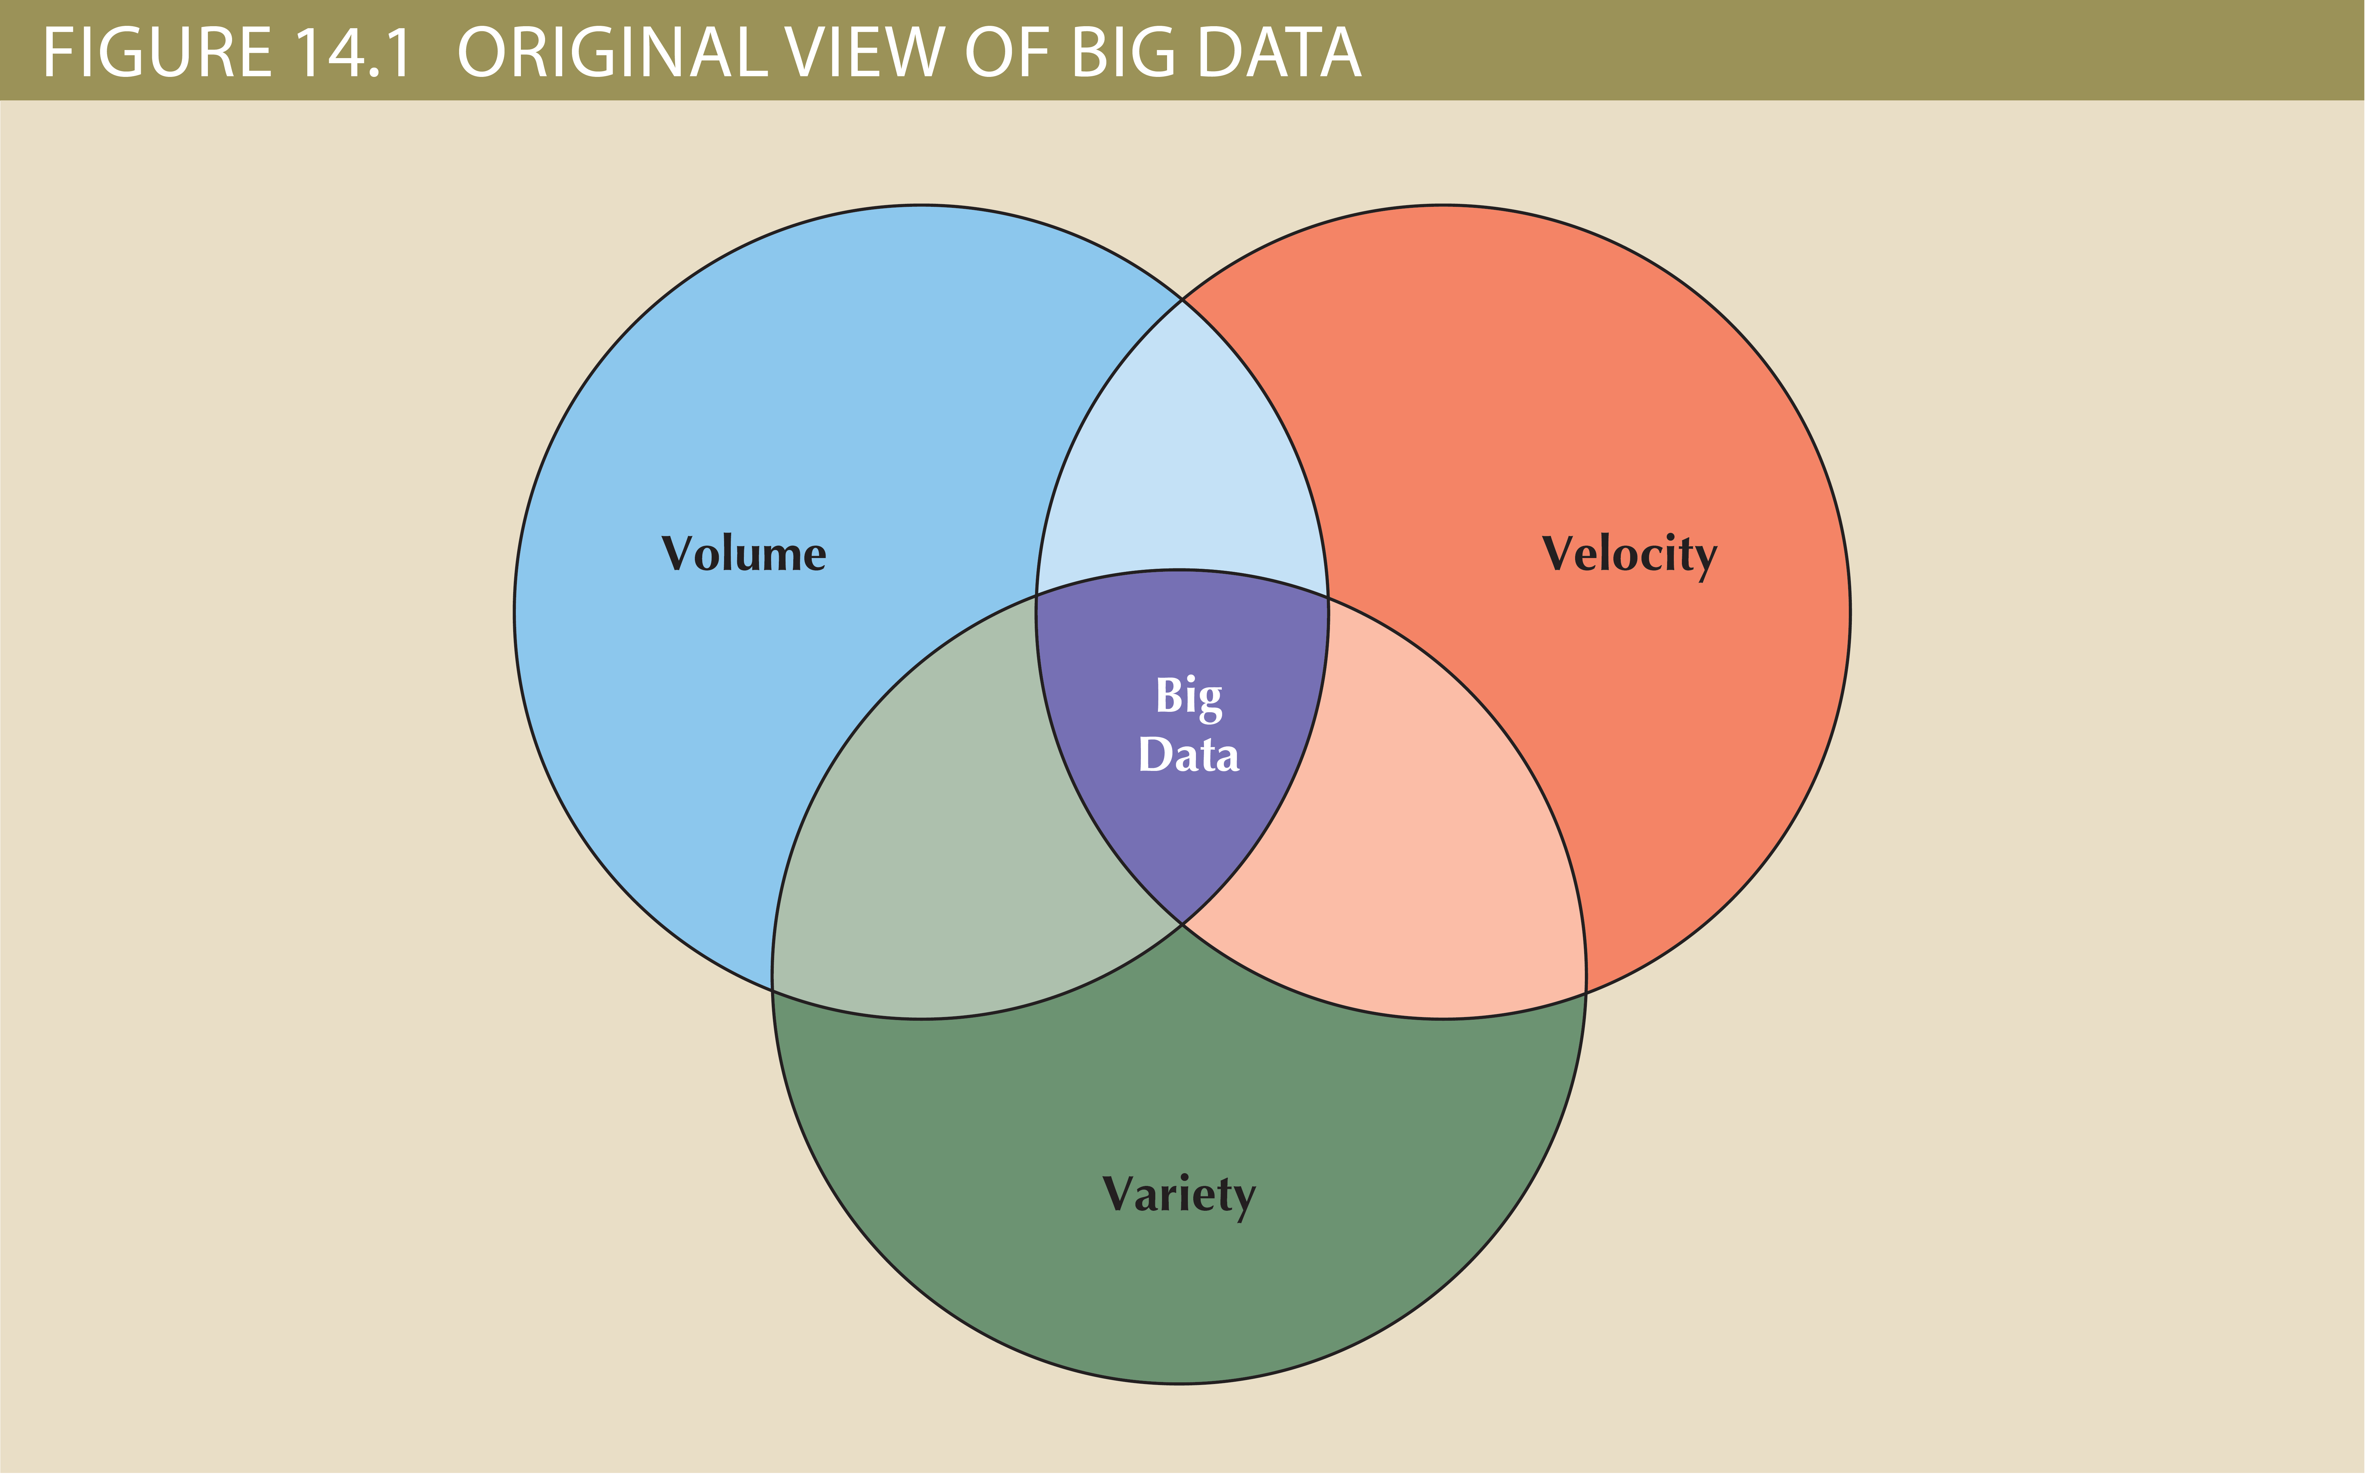
Big Data (2 of 4)

Slide 5
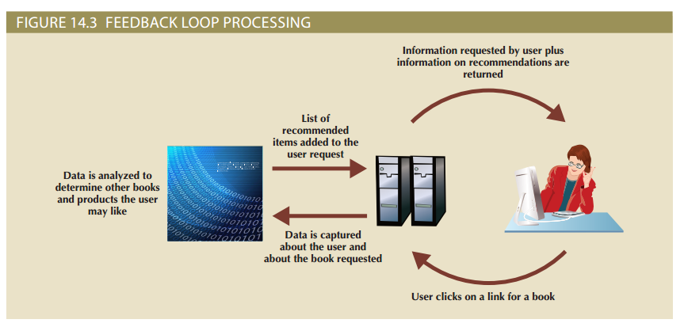
Big Data (3 of 4)

Slide 6
Big Data (4 of 4)
Other characteristics
Variability: changes in meaning of data based on context
Sentimental analysis: attempts to determine if a statement conveys a positive, negative, or neutral attitude about a topic
Veracity: trustworthiness of data
Value: degree data can be analyzed for meaningful insight
Visualization: ability to graphically resent data to make it understandable
Relational databases are not necessarily the best for storing and managing all organizational data
Polyglot persistence: coexistence of a variety of data storage and management technologies within an organization’s infrastructure

Slide 7
Hadoop (1 of 8)
De facto standard for most Big Data storage and processing
Java-based framework for distributing and processing very large data sets across clusters of computers
Important components
Hadoop Distributed File System (HDFS): low-level distributed file processing system that can be used directly for data storage
MapReduce: programming model that supports processing large data sets

Slide 8
Hadoop (2 of 8)
Hadoop Distributed File System (HDFS)
Based on several key assumptions
High volume: default block sizes is 64 MB and can be configured to even larger values
Write-once, read-many: model simplifies concurrency issues and improves data throughput
Streaming access: optimized for batch processing of entire files as a continuous stream of data
Fault tolerance: designed to replicate data across many different devices so that when one fails, data is still available from another device

Slide 9
Hadoop (3 of 8)
Hadoop uses several types of nodes; computers that perform one or more types of tasks within the system
Data node store the actual file data
Name node contains file system metadata
Client node makes requests to the file system as needed to support user applications
Data node communicates with name node and send back block reports and heartbeats

Slide 10
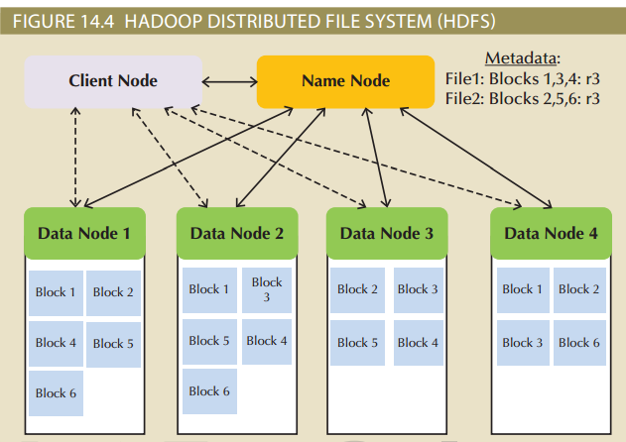
Hadoop (4 of 8)

Slide 11
Hadoop (5 of 8)
MapReduce
Framework used to process large data sets across clusters
Breaks down complex tasks into smaller subtasks, performing the subtasks, and producing a final result
Map function takes a collection of data and sorts and filters it into a set of key-value pairs
Mapper program performs the map function
Reduce summaries results of map function produce a single result
Reducer program performs the reduce function
Implementation complements HDFS structure
Job tracker: central control program
Task tracker: reduces tasks on a node
Batch processing: runs tasks from beginning to end with no user interaction

Slide 12
Hadoop (6 of 8)
Hadoop ecosystem
Most organizations that use Hadoop also use a set of other related products that interact and complement each other to produce an entire ecosystem of applications and tools
Like any ecosystem, the interconnected pieces are constantly evolving and their relationships are changing, so it is a rather fluid situation

Slide 13
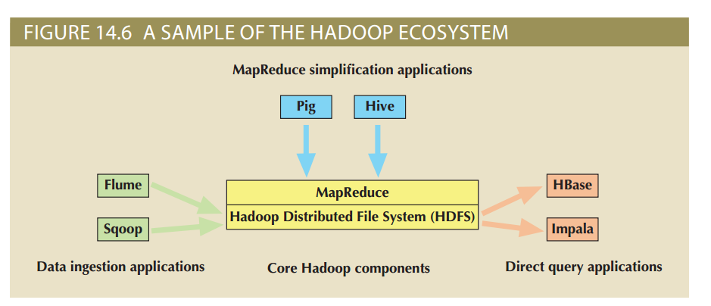
Hadoop (7 of 8)

Slide 14
Hadoop (8 of 8)
Map reduce simplification applications
Hive: data warehousing system that sites on top of HDFS and supports its own SQL-like language
Pig: tool that compiles a high-level scripting language, named Pig Latin, into MapReduce jobs for executing in Hadoop
Data ingestion applications
Flume: component for ingesting data in Hadoop
Sqoop: tool for converting data back and forth between a relational database and the HDFS
Direct query applications
Hbase: column-oriented NoSQL database designed to sit on top of the HDFS that quickly processes sparse datasets
Impala: the first SQL on Hadoop application

Slide 15
NoSQL (1 of 7)
Nosql: non-relational database technologies developed to address Big Data challenges
Name does not describe what the NoSQL technologies are, but rather what they are not (poor job of that as well)
Key-value (KV) databases: conceptually the simplest of the NoSQL data models
Store data as a collection of key-value pairs organized as buckets which are the equivalent of tables
Document databases: similar to key-value databases and can almost be considered a subtype of KV databases
Store data in key-value pairs in which the value components are encoded documents grouped into large groups called collections

Slide 16
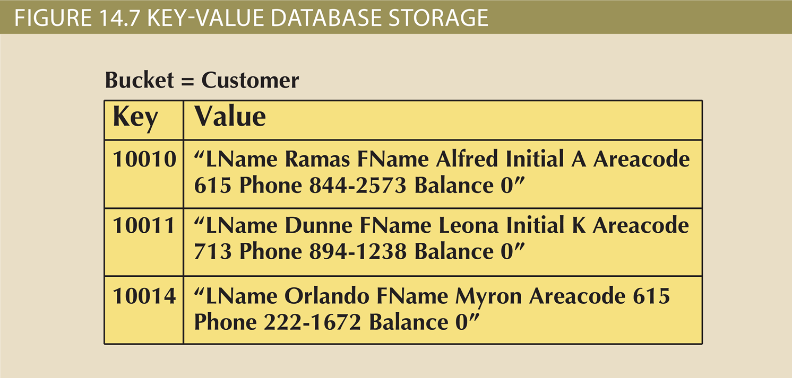
NoSQL (2 of 7)

Slide 17
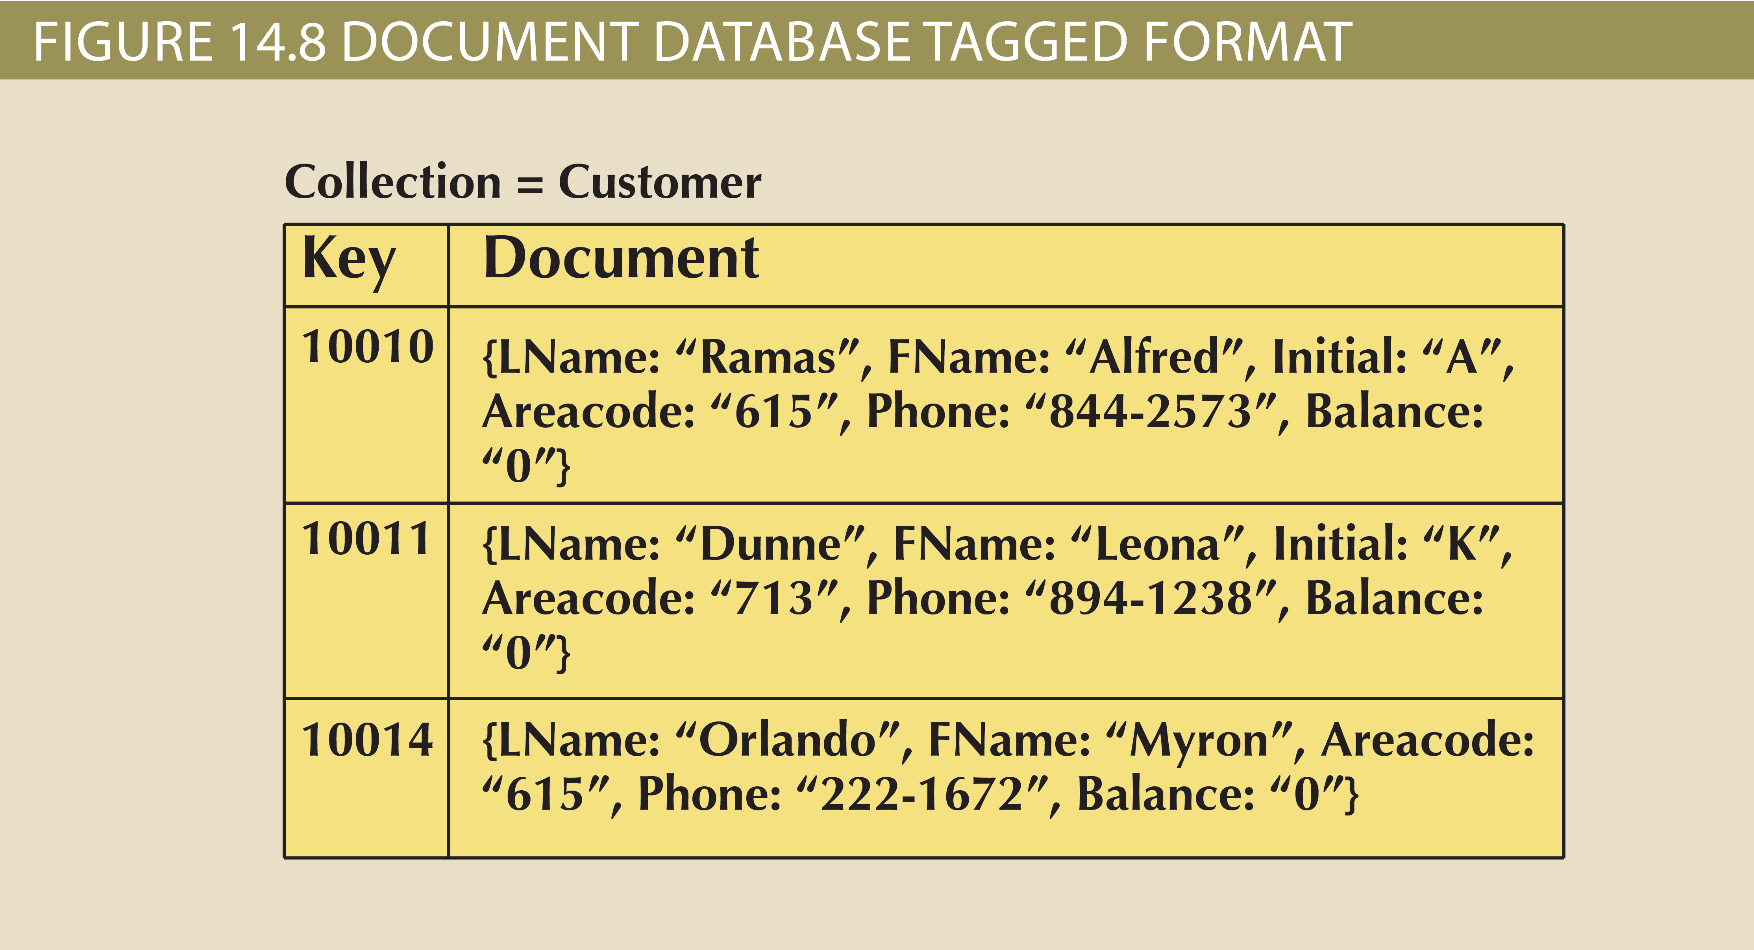
NoSQL (3 of 7)

Slide 18
NoSQL (4 of 7)
Column-oriented databases refers to two technologies
Column-centric storage: data stored in blocks which hold data from a single column across many rows
Row-centric storage: data stored in block which hold data from all columns of a given set of rows
Graph databases store data on relationship-rich data as a collection of nodes and edges
Properties: like attributes; they are the data that we need to store about the node
Traversal: query in a graph database

Slide 19
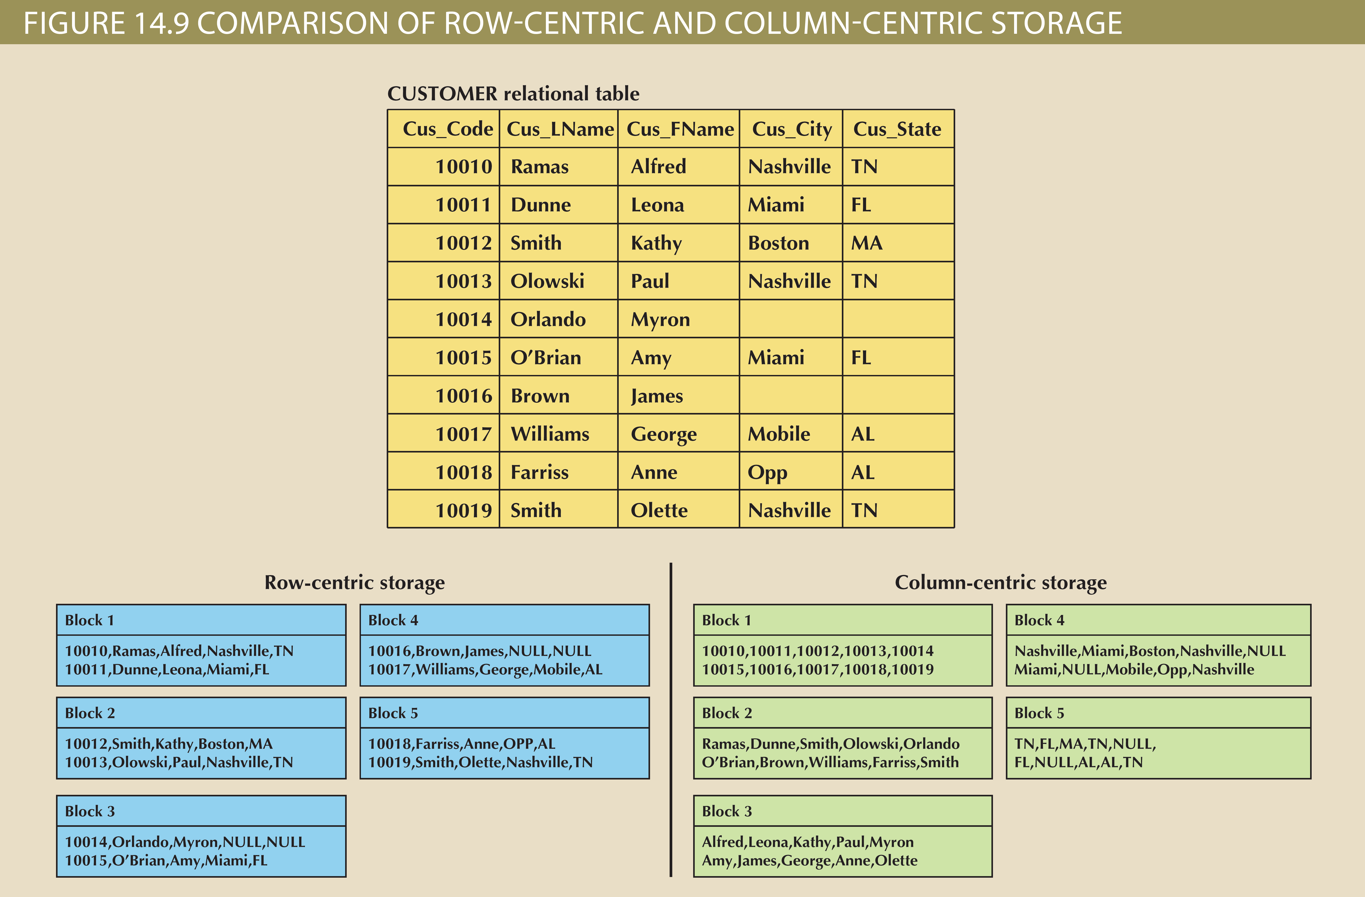
NoSQL (5 of 7)

Slide 20
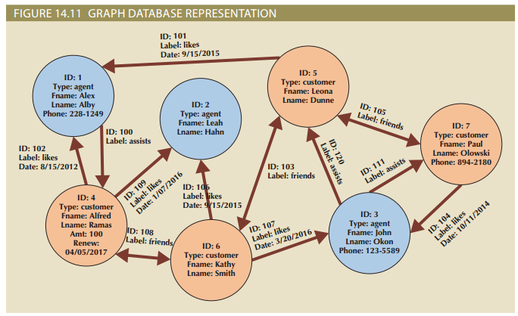
NoSQL (6 of 7)

Slide 21
NoSQL (7 of 7)
Aggregate awareness: data is collected or aggregated around a central topic or entity
Aggregate aware database models achieve clustering efficiency by making each piece of data relatively independent
Graph databases, like relational databases, are aggregate ignorant
Do not organize the data into collections based on a central entity

Slide 22
NewSQL Databases (1 of 2)
Database model that attempts to provide ACID-compliant transactions across a highly distributed infrastructure
Latest technologies to appear in the data management area to address Big Data problems
No proven track record
Have been adopted by relatively few organizations

Slide 23
NewSQL Databases (2 of 2)
NewSQL databases support:
SQL as the primary interface
ACID-compliant transactions
Similar to NoSQL, NewSQL databases also support:
Highly distributed clusters
Key-value or column-oriented data stores

Slide 24
Working with Document Databases Using MongoDB (1 of 2)
Popular document database
Among the NoSQL databases currently available, MongoDB has been one of the most successful in penetrating the database market
MongoDB, comes from the word humongous as its developers intended their new product to support extremely large data sets
High availability
High scalability
High performance

Slide 25
Working with Document Databases Using MongoDB (2 of 2)
Importing Documents in MongoDB
Refer to the text for an importation example and considerations
Example of a MongoDB Query Using find()
Methods are programed functions to manipulate objects
Find() method retrieves objects from a collection that match the restrictions provided
Pretty() method is used to improve readability of the documents by placing key:value pairs on separate lines
Refer to the text for a query example

Slide 26
Working with Graph Databases Using Neo4j (1 of 3)
Even though Neo4j is not yet as widely adopted as MongoDB, it has been one of the fastest growing NoSQL databases
Graph databases still work with concepts similar to entities and relationships
Focus is on the relationships
Graph databases are used in environments with complex relationships among entities
Heavily reliant on interdependence among their data
Neo4j provides several interface options
Designed with Java programming in mind
Creating nodes in Neo4j
Nodes in a graph database correspond to entity instances in a relational database
Cypher is the interactive, declarative query language in Neo4j
Nodes and relationships are created using a CREATE command

Slide 27
Working with Graph Databases Using Neo4j (2 of 3)
Refer to the text for examples
Using the CREATE command to create a member node
Retrieving node data with MATCH and WHERE
Retrieving relationship data with MATCH and WHERE

Slide 28
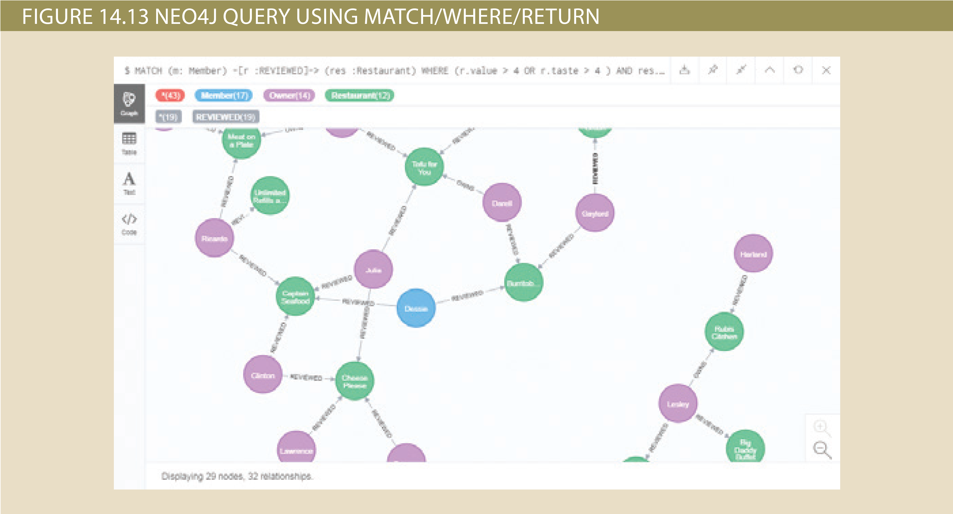
Working with Graph Databases Using Neo4j (3 of 3)

Slide 29
Summary (1 of 2)
Big Data is characterized by data of such volume, velocity, and/or variety that the relational model struggles to adapt to it
Volume, velocity, and variety are collectively referred to as the 3 Vs of Big Data
The Hadoop framework has quickly emerged as a standard for the physical storage of Big Data
NoSQL is a broad term to refer to any of several nonrelational database approaches to data management
Key-value databases store data in key-value pairs
Document databases also store data in key-value pairs, but the data in the value component is an encoded document

Slide 30
Summary (2 of 2)
Column-oriented databases, also called column family databases, organize data into key-value pairs in which the value component is composed of a series of columns, which are themselves key-value pairs
Graph databases are based on graph theory and represent data through nodes, edges, and properties
NewSQL databases attempt to integrate features of both RDBMS (providing ACID-compliant transactions) and NoSQL databases (using a highly distributed infrastructure)
MongoDB is a document database that stores documents in JSON format
Neo4j is a graph database that stores data as nodes and relationships, both of which can contain properties to describe them

